Slide 1

The Impact of Israel-Palestine conflict on the Global Economy
Sidhant Narayan

Slide 2
Introduction Claims to the Land
Israelis
Palestinians
Jewish people with religious and historical ties to the land.
Historical connection dating back thousands of years.
View the land as their ancestral homeland, promised to them by divine covenant.
Muslim Arabs with religious and historical ties to the land.
Indigenous population with roots tracing back generations.
View the land as their ancestral homeland, integral to their cultural and religious identity.

Slide 3
A Historical Overview of this conflict
Ancient History: Biblical Origins to Roman Conquests
Modern History: Ottoman Rule and Emergence of Zionism
Mandatory Palestine: British Rule and Demographic Changes
Formation of Israel: UN Partition Plan and Arab-Israeli War
Post-Independence Wars: Six-Day War to Yom Kippur War
Intifadas: First and Second Uprisings against Occupation
Lebanon Wars and Hezbollah: Israeli Invasions and Resistance
Rise of Hamas and Conflict in Gaza
Current Situation: Tensions and Violence in Jerusalem
International Perspectives on the Conflict
Significance of Jerusalem: Religious and Historical Importance

Slide 4

Global Economic Ripple Effects
The Israel-Palestine conflict has far-reaching economic consequences, affecting not only the Middle East but also the global economy.

Slide 5
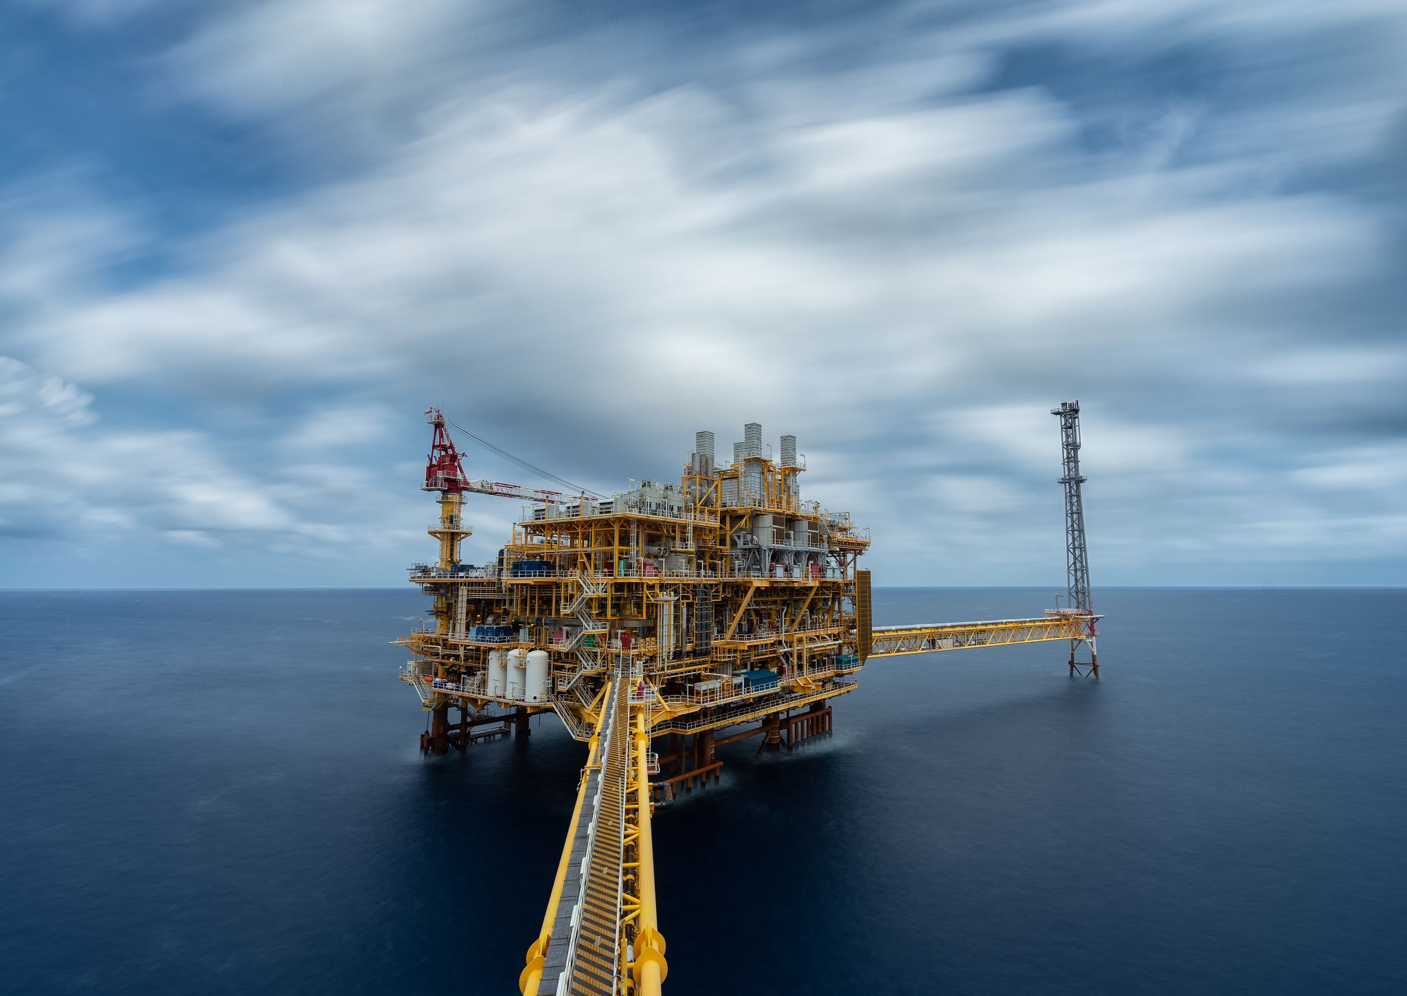
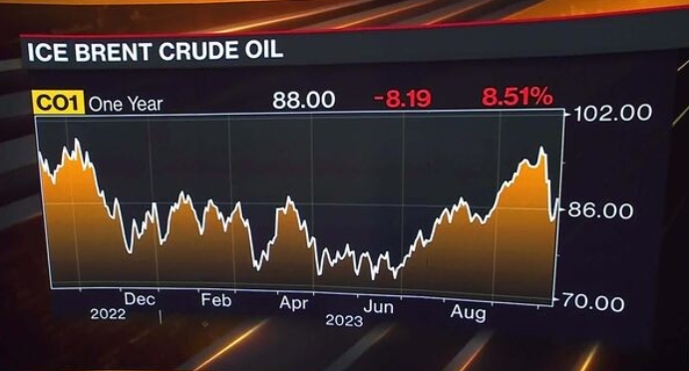
Energy Markets and Oil Prices
Oil Production: The Middle East is home to some of the world's largest oil-producing countries, including Saudi Arabia, Iran, Iraq, and the United Arab Emirates.
Recent escalation of tensions in the Middle East has led to a significant surge in crude oil prices.
Nearly one-third of the global oil supply originates from the Middle East, making it a critical region for energy markets.
Brent crude prices surged by 3.44% to reach $87.49 per barrel.
US West Texas Intermediate crude rallied by 3.85% to hit $85.98 per barrel.
Market response reflects concerns over potential disruptions to oil supply due to increased geopolitical tensions.

Slide 6

Global Market Update: Impact of Israel-Hamas Conflict
Equity markets react: Israel-Hamas conflict sparks investor caution, leading to a shift towards safe-haven assets.
US stock futures decline: Anticipated uncertainty prompts a downturn in US stock futures.
Asian markets follow suit: Asian markets trade lower as risk-off sentiment prevails.
Gold prices surge: Safe-haven demand drives spot gold up by 1.2% to $1,853.79 per ounce.
Opportunity in gold: Rising tensions prompt investors to consider gold as a safe-haven asset.
Currency movements: Dollar and Japanese yen strengthen amid market uncertainty, with the dollar index up 0.1% at 106.33.
Investor sentiment: Chief Investment Strategist VK Vijayakumar advises caution, suggesting long-term investors accumulate high-quality stocks gradually.
FII selling persists: Foreign institutional investors continue to sell amid concerns over higher bond yields.
Potential challenges: High crude oil prices add to market concerns, potentially exacerbating existing issues.

Slide 7
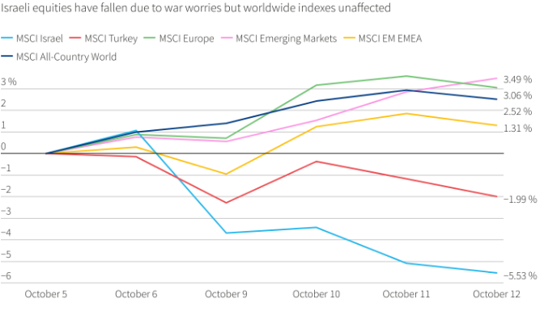
Stock Market
That has come as officials at the world's most influential central banks such as the Federal Reserve and European Central Bank have made comments hinting that their relentless run of interest rate hikes may be wrapping up.
But top-rated government bonds also have a traditional safe-haven appeal, so they are a natural place for investors to park their money during times of geopolitical stress.

Slide 8
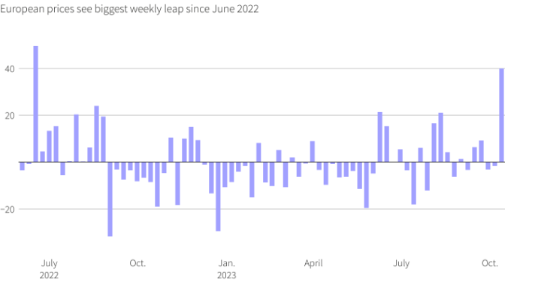
Natural gas price unexpected jump
Brent oil has shoot up over 5%, its biggest weekly jump since April , while European gas prices have seen a near 40% surge, the largest weekly leap of the year so far.
It hasn't just been down to the conflict, though. On Thursday, the United States imposed the first sanctions on owners of tankers carrying Russian oil priced above the G7's price cap of $60 a barrel to close loopholes in the mechanism designed to punish Moscow for its invasion of Ukraine.

Slide 9
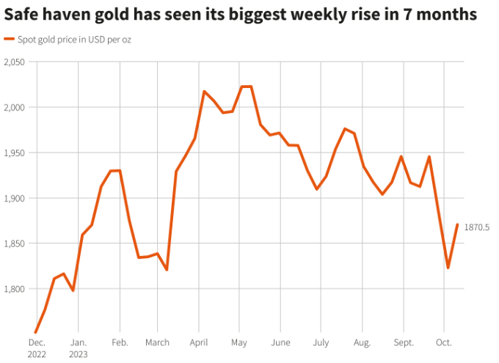
GOLD SHINES
Safe-haven gold has had its best week since mid-March with a near 3% rise. As with stocks, lower bond market yields have probably helped too, as they has shaved down the premium that bonds offer investors compared to non-interest paying bullion.

Slide 10
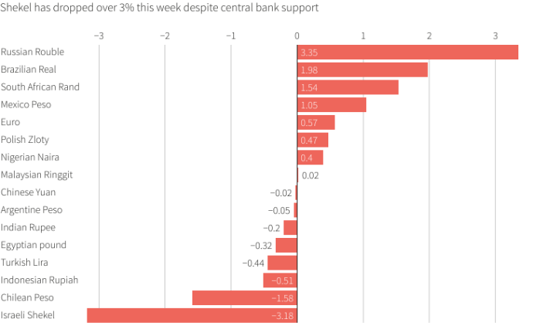
WEAKEST OF THE WEEK
Perhaps unsurprisingly, Israel's shekel currency has had the weakest week in FX markets.
Its more than 3% drop marks its biggest weekly fall since February when concerns about rule of law changes were still raw. But this week's decline has also come as the country's central bank put $30 billion of its reverse on the line to support the shekel.

Slide 11
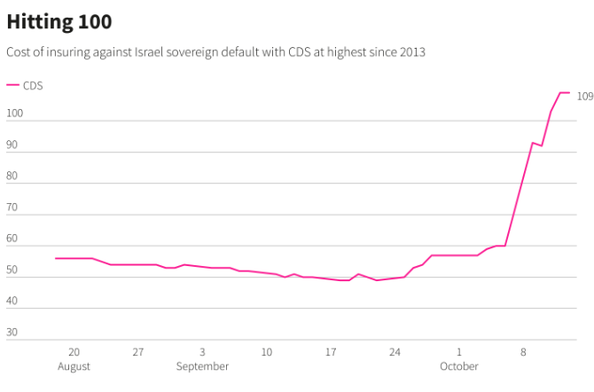
LOCAL IMPACT
Another clear sign of stress in Israel's markets has been a huge spike in the cost of ensuring its government debt using what are known as credit default swaps (CDS).
Investors use CDS either as a protection tool or to speculate and this week the cost of buying Israel CDS has surged 80%.
On top of that, Moody's is scheduled to review Israel's 'A1' credit rating late on Friday. The country has never been downgraded by any of the three major rating agencies - S&P, Moody's and Fitch - but the rise in CDS means that it now costs the same to ensure Israel exposure as it does for India, which is five rating levels below Israel on the lowest rung of 'investment grade'.

Slide 12

Conclusion
The Israel-Palestine conflict casts a long shadow over the global economy, with ramifications reaching far beyond the borders of the region.
In conclusion, resolving the Israel-Palestine conflict is not just a moral imperative but also an economic necessity for fostering global stability and prosperity. Let us work together towards a future where peace, dignity, and prosperity prevail for all people in the region and beyond. Thank you.

Slide 13

Thank you

